Slide 1
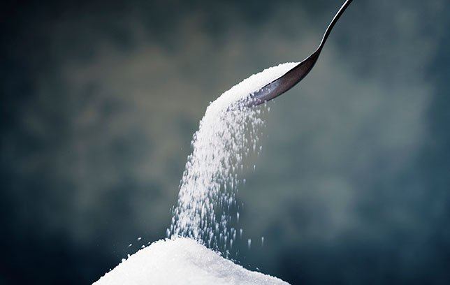
Daily Review
Solutions are formed when one substance dissolves in another.
Soluble substances dissolve, forming a solution.
Insoluble substances don’t dissolve, and can’t form solutions.
Create the following table on your whiteboard:
Classify the following substances as soluble or insoluble.
Salt Sand Sugar
Jelly powder Paper Oil
Detergent Cordial Steel
Soluble | Insoluble

Slide 2
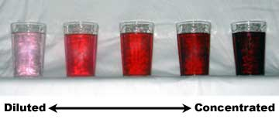
Daily Review
Solutions can be compared in terms of their concentration (how much solute they contain – how ‘strong’ they are).
A dilute solution has only a little solute dissolved.
A concentrated solution has a lot of solute dissolved.
If no more solute can dissolve, the solution is saturated.
CFU
Which numbered cup is most dilute?
CFU
Which numbered cup contains the most solute?
CFU
What could you do to dilute cup 5?
Vocabulary
sol·ute (noun) the substance that is dissolved in a solution con·cen·tra·tion (noun) how ‘strong’ a solution is
1 2 3 4 5

Slide 3
Separating Mixtures: Evaporation and Crystallisation Year 7 Science

Slide 4

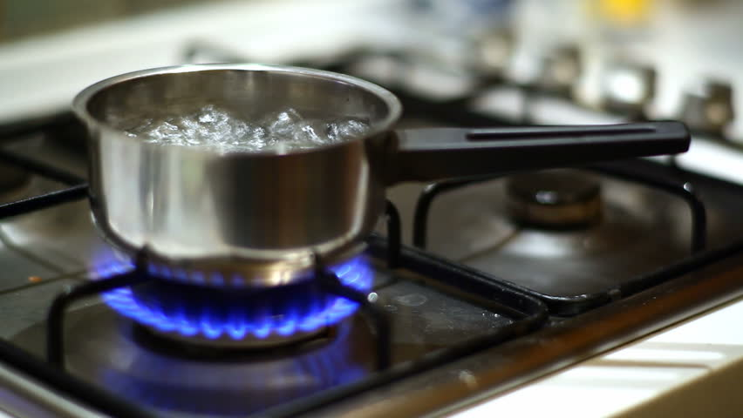
Learning Objectives
CFU
Which two ways of separating mixtures are we learning about today?
Define evaporation.
Describe how to separate mixtures using evaporation and crystallisation.
Activate Prior Knowledge
Think, Pair, Share: what are some of the differences between evaporation and boiling? What are some of the similarities?

Slide 5
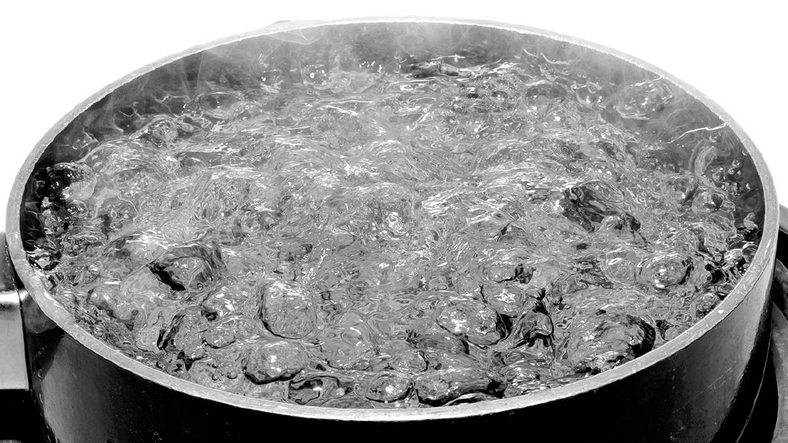
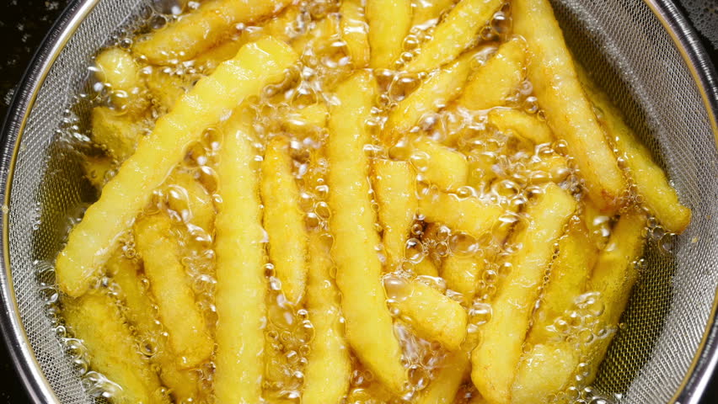
Concept Development
CFU 1
If you heat a mixture of olive oil and water, which one will turn into a gas first? Why?
Evaporation
A liquid will slowly turn into a gas even when it is not boiling. This is called evaporation. However, a liquid will turn into a gas much faster when it is boiling.
Different liquids boil at different temperatures. For example, water boils at 100 °C, but olive oil boils at 300 °C.
CFU 2
What are the differences between evaporation and boiling?
Vocabulary
e·vap·o·rate (verb) turn into a gas, usually at the surface of a liquid boi·l (verb) turn into a gas, throughout a liquid

Slide 6
Concept Development
Substance | Boiling Point (°C)
chloroform | 61.2
methanol | 64.7
nitric acid | 83
sea water | 100.7
sulfuric acid | 337
water | 100
Evaporation
The different boiling points of liquids can be used to separate them in a mixture: when the mixture is heated, one liquid will evaporate, leaving the other behind. This is also called evaporation.
Using the boiling points on the right, write the names of the substances that would be left behind on your whiteboard.
Vocabulary – look out!
e·vap·o·ra·tion (noun) a liquid turning into a gas at its surface e·vap·o·ra·tion (noun) heating a mixture of liquids until one liquid turns into a gas, leaving the other liquid behind
Mixture being heated | Substance left behind
Water and chloroform
Nitric acid and sea water
Methanol and sulfuric acid

Slide 7
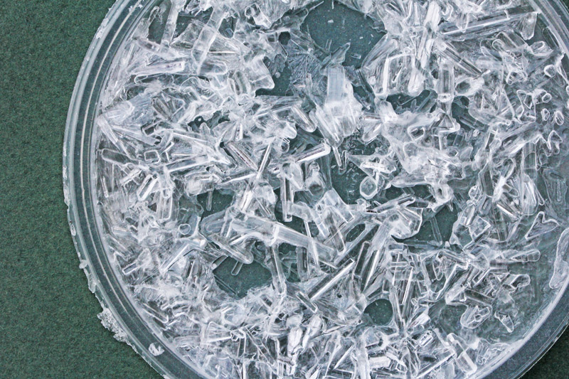
Concept Development
CFU 1
Think, Pair, Share: what do evaporation and crystallisation have in common? What are the differences?
Crystallisation
Heating a solution allows us to quickly separate the solute from the solvent.
For example, salt boils at 1413 °C. If a salt water solution is heated, the water will evaporate first, leaving the salt behind.
Vocabulary
sol·ute (noun) the substance that is dissolved in a solution sol·vent (noun) the substance that the solute is dissolved in | e·vap·o·ra·tion (noun) heating a mixture of liquids until one liquid turns into a gas, leaving the other liquid behind crys·tall·i·sa·tion (noun) heating a solution to boil the solvent, leaving the solute behind as a solid

Slide 8
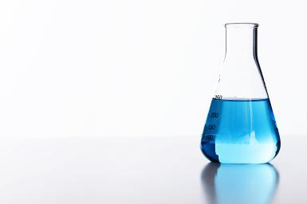
Skill Development/Guided Practice
CFU 1
Would crystallisation be useful if the chemist wanted to keep the water from the solution? Why or why not?
Which technique?
A chemist has some leftover copper sulfate solution. She wants to store the copper sulfate as a solid, without all the water it’s dissolved in. What should she do?
The mixture is a solution and the chemist wants to keep the solid, so she should use crystallisation.
Identifying a separation technique
1. If there is a mixture of liquids with different boiling points, and you want the one with the higher boiling point: evaporation 2. If the mixture is a solution, and you want the solid: crystallisation
Vocabulary
e·vap·o·ra·tion (noun) heating a mixture of liquids until one liquid turns into a gas, leaving the other liquid behind crys·tall·i·sa·tion (noun) heating a solution to boil the solvent, leaving the solute behind as a solid

Slide 9
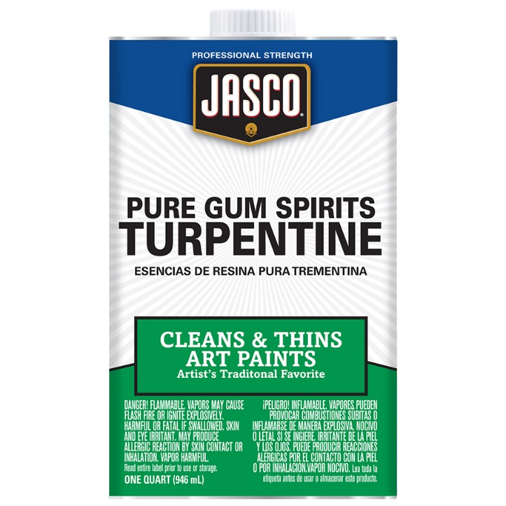
Skill Development/Guided Practice
CFU 1
Will the turpentine or the water be left behind after evaporation? How do you know?
Which technique?
A painter has accidentally mixed some turpentine with some water. Turpentine boils at 160 °C and water boils at 100 °C. How can he separate the two?
The mixture contains two liquids with different boiling points, so he should use evaporation.
Identifying a separation technique
1. If there is a mixture of liquids with different boiling points, and you want the one with the higher boiling point: evaporation 2. If the mixture is a solution, and you want the solid: crystallisation
Vocabulary
e·vap·o·ra·tion (noun) heating a mixture of liquids until one liquid turns into a gas, leaving the other liquid behind crys·tall·i·sa·tion (noun) heating a solution to boil the solvent, leaving the solute behind as a solid

Slide 10
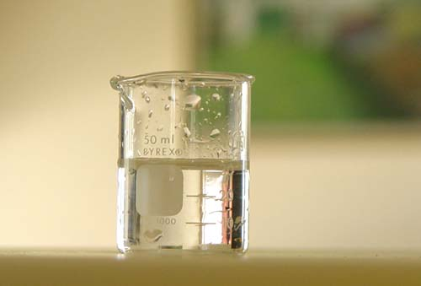
Skill Development/Guided Practice
Which technique?
A scientist accidentally contaminates the water he needs to use in an experiment with methanol. Methanol boils at 65°C and water boils at 100°C. How could he purify his water?
Identifying a separation technique
1. If there is a mixture of liquids with different boiling points, and you want the one with the higher boiling point: evaporation 2. If the mixture is a solution, and you want the solid: crystallisation
Vocabulary
e·vap·o·ra·tion (noun) heating a mixture of liquids until one liquid turns into a gas, leaving the other liquid behind crys·tall·i·sa·tion (noun) heating a solution to boil the solvent, leaving the solute behind as a solid

Slide 11

Skill Development/Guided Practice
Which technique?
A company wants to separate sea salt from sea water. What technique should they use?
Identifying a separation technique
1. If there is a mixture of liquids with different boiling points, and you want the one with the higher boiling point: evaporation 2. If the mixture is a solution, and you want the solid: crystallisation
Vocabulary
e·vap·o·ra·tion (noun) heating a mixture of liquids until one liquid turns into a gas, leaving the other liquid behind crys·tall·i·sa·tion (noun) heating a solution to boil the solvent, leaving the solute behind as a solid

Slide 12
Relevance
Evaporation and crystallisation are used in food production and in the pharmaceutical industry.
You will soon be conducting an experiment in which you will use crystallisation.

Slide 13
Skill Closure
Substance | Boiling Point (°C)
chloroform | 61.2
methanol | 64.7
nitric acid | 83
sea water | 100.7
sulfuric acid | 337
water | 100
Using the boiling points on the right, write the names of the substances that would evaporate first on your whiteboard.
When using crystallisation, what is left behind: the solute or the solvent? What happens to the other one?
Mixture being heated | Substance that evaporates first
Water and nitric acid
Sulfuric acid and methanol
Chloroform and sulfuric acid
Vocabulary
e·vap·o·ra·tion (noun) heating a mixture of liquids until one liquid turns into a gas, leaving the other liquid behind crys·tall·i·sa·tion (noun) heating a solution to boil the solvent, leaving the solute behind as a solid

Slide 14
Independent Practice
Complete the first page of the worksheet. If you are using a device, use Excel to make the graph.

